Slide 1

Mobile Application Development
Welcome
Class: BS(CS)-VII
Sukkur IBA University – Kandhkot Campus
Week - 06
Lecture – 11 & 12
Your Facilitator, Adil Khan

Slide 2
Making calls and sending SMS

Slide 3

Making a call
We can make a phone call in android via intent. You need to write only three lines of code to make a phone call.

Slide 4
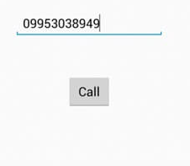
Making a call

Slide 5
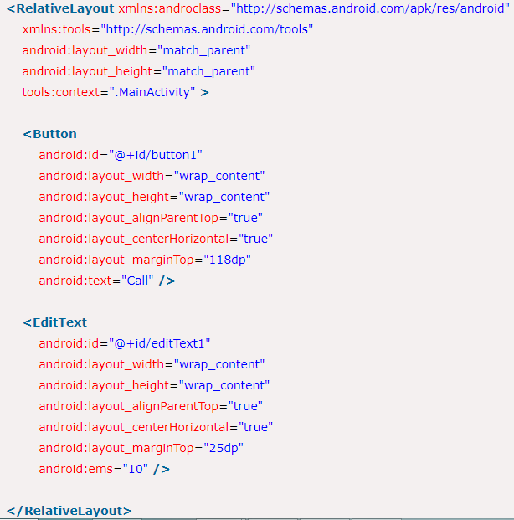
Making a call

Slide 6
Write the permission in AndroidManifest.xml
We need to write CALL_PHONE permission as given below:

Slide 7
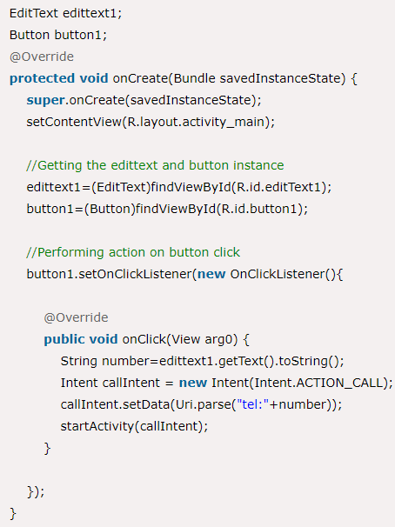
Java Code

Slide 8
Sending SMS
In android, we can send SMS from our android application in two ways either by using SMSManager API or Intents based on our requirements.
If we use SMSManager API, it will directly send SMS from our application.
In case if we use Intent with proper action (ACTION_VIEW), it will invoke a built-in SMS app to send SMS from our application.

Slide 9
Example using SMSManager API
In android, to send SMS using SMSManager API we need to write the code like as shown below.

Slide 10
Example using SMSManager API
SMSManager API requires SEND_SMS permission in our android manifest to send SMS.
Following is the code snippet to set SEND_SMS permissions in manifest file.

Slide 11
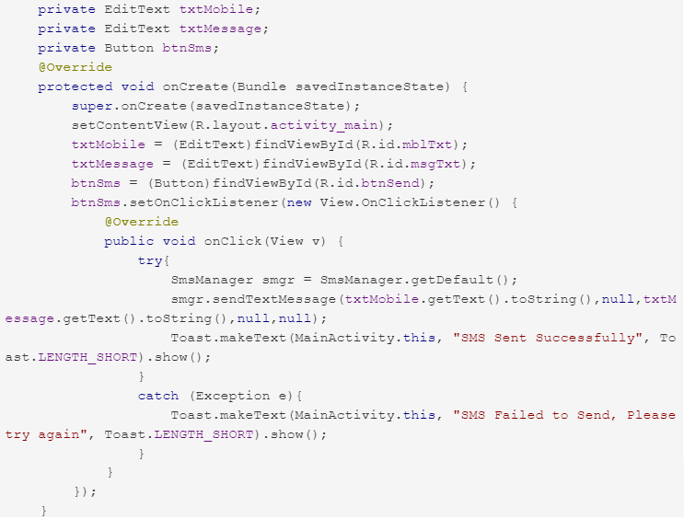
Example using SMSManager API

Slide 12
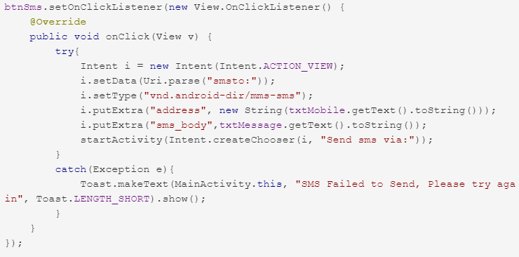
Example using Intent
This example is using the device’s build-in SMS application to send out the SMS message.

Slide 13
Playing Video

Slide 14
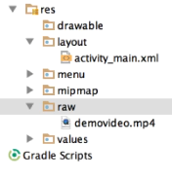
Playing Video
Create a folder names raw in the res directory
Save your video file inside that raw folder

Slide 15
Playing Video
Put a VideoView widget on layout
public void onCreate(…) {
VideoView vid = (VideoView) findViewById(R.id.videoView);
Vid.setVideoPath(“android.resource://” + getPackageName() + “/” + R.raw.demovideo);
Vid.start();
// ...

Slide 16
Playing Video
This code will simply start playing video.
However, if you want additional features like pause, forward, backward etc., then you will have to use the MediaController class.

Slide 17
Playing Video
public void onCreate(…) {
VideoView vid = (VideoView) findViewById(R.id.videoView);
Vid.setVideoPath(“android.resource://” + getPackageName() + “/” + R.raw.demovideo);
MediaController cont = new MediaController(this);
Cont.setAnchorView(vid);
vid.setMediaController(cont);
vid.start();
// ...

Slide 18
Thank you!
Any Questions???

